Slide 1
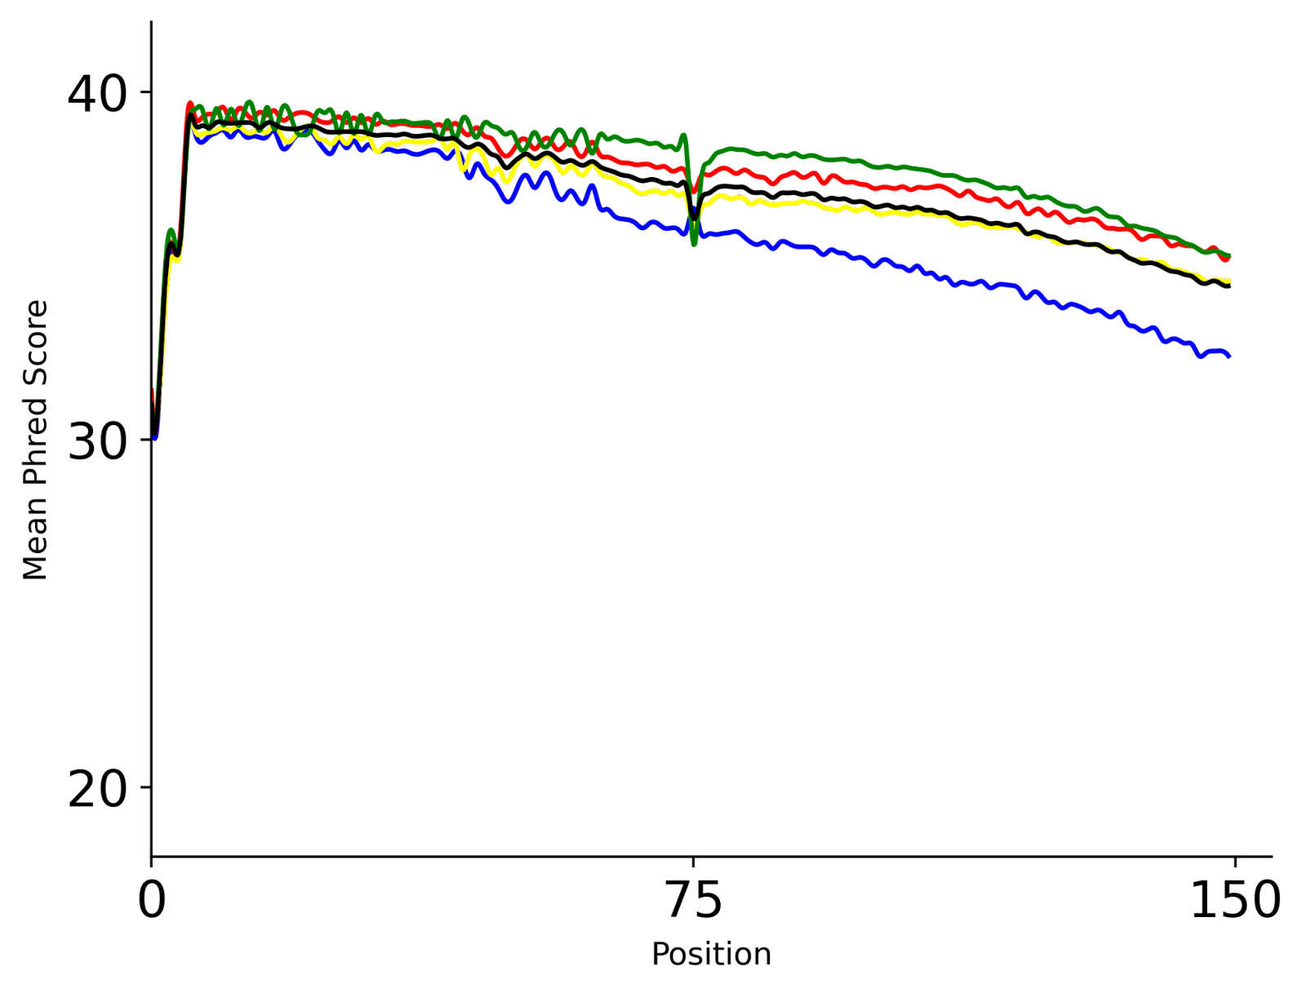
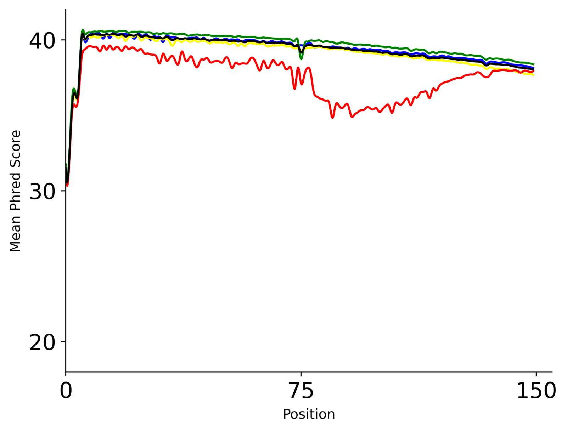
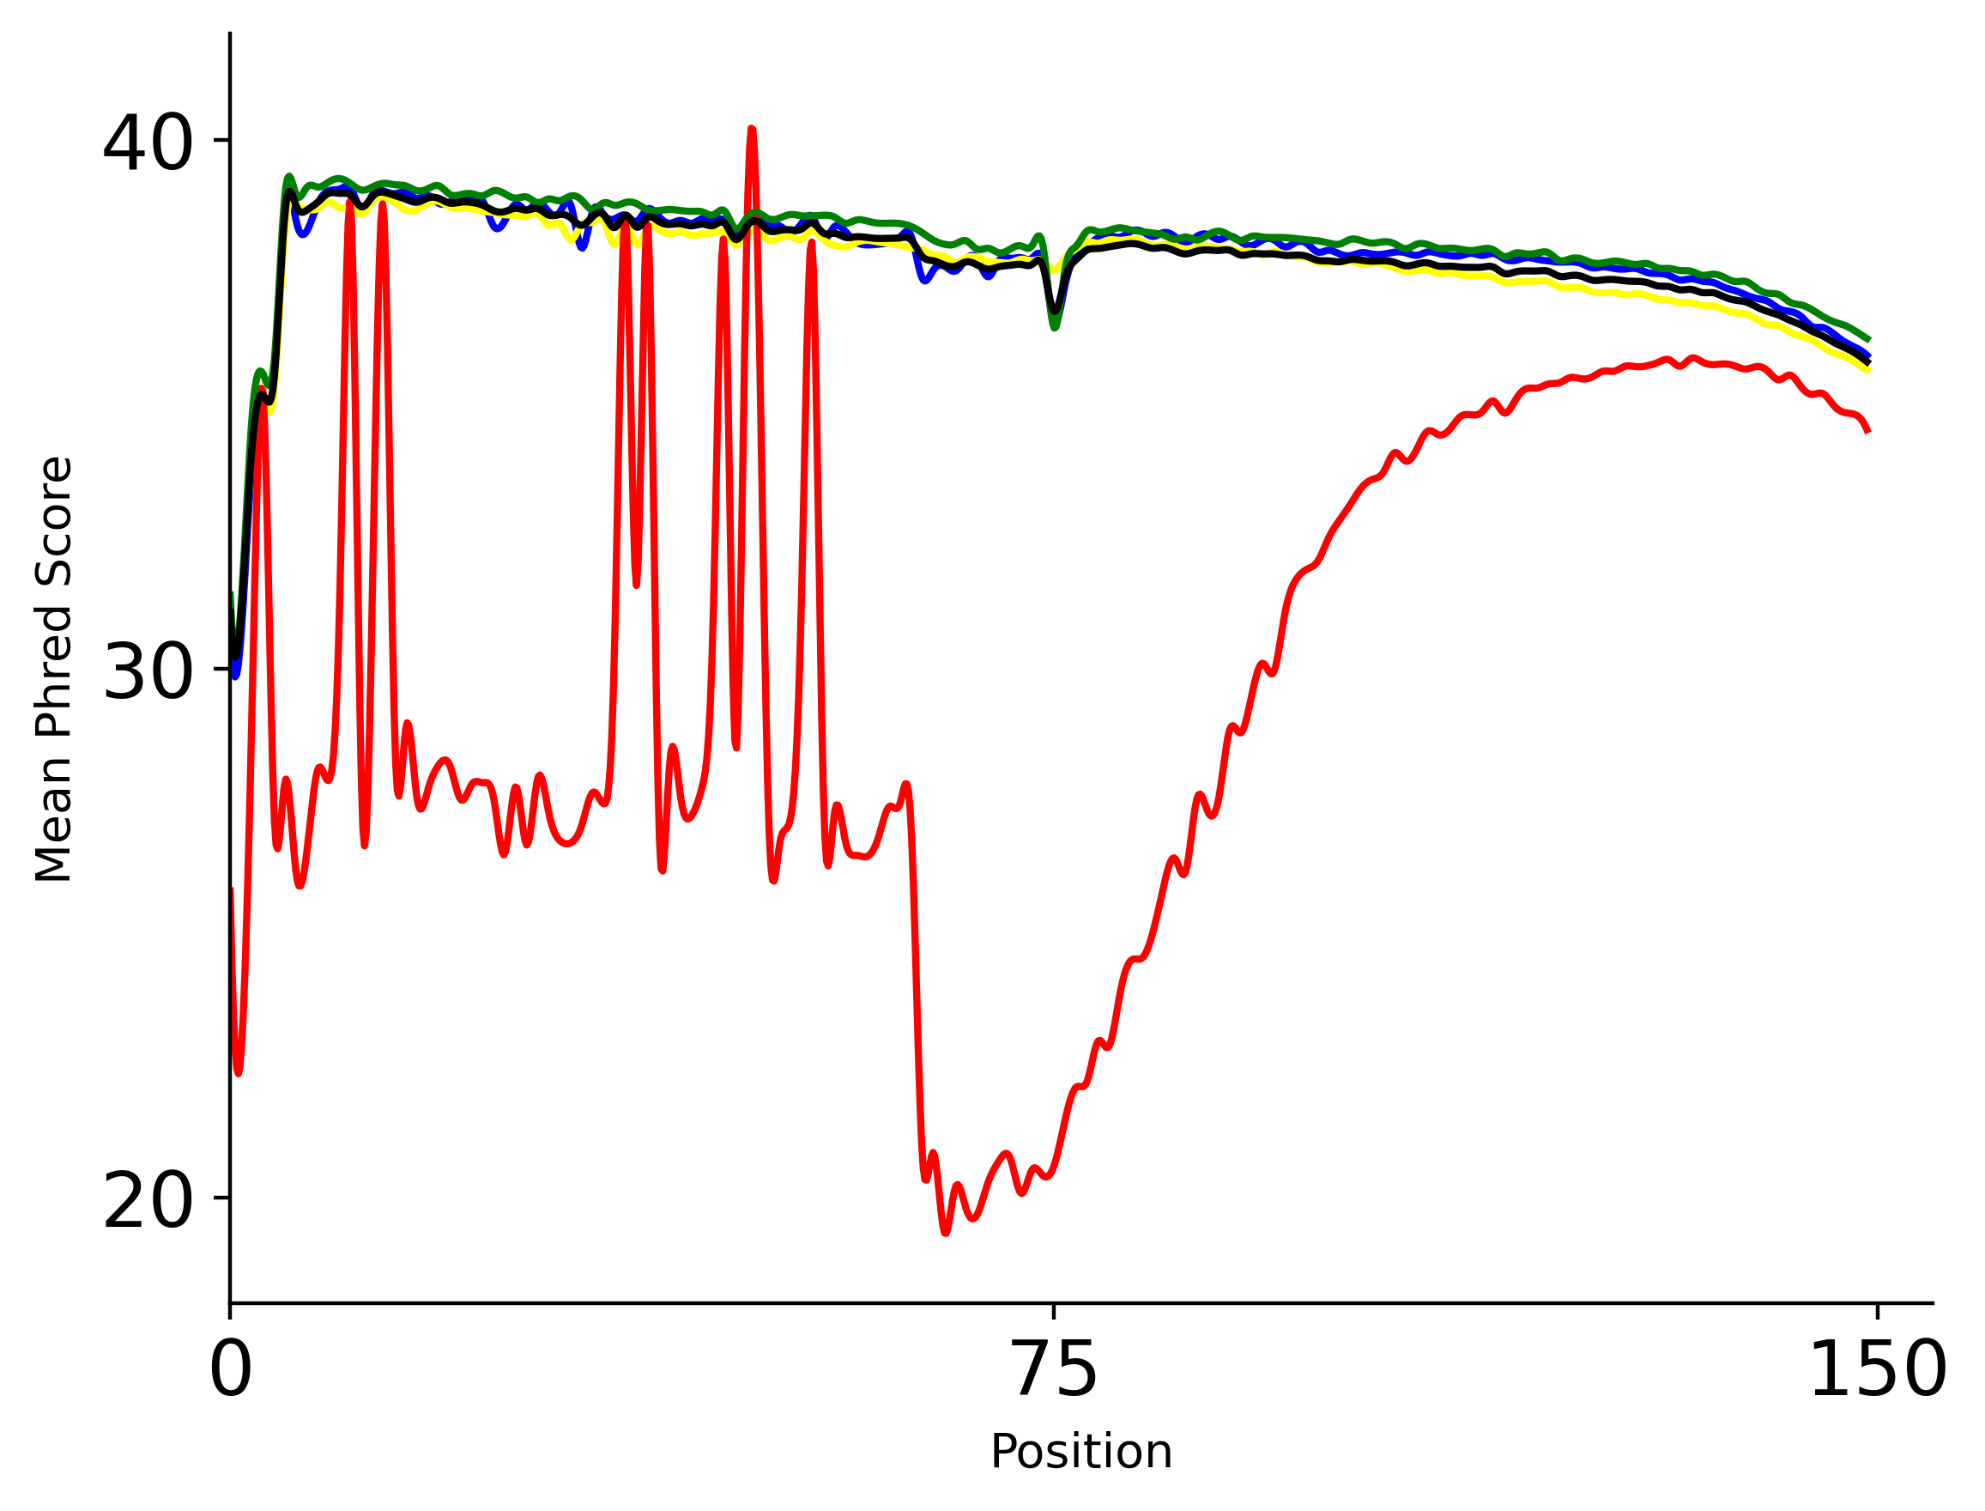


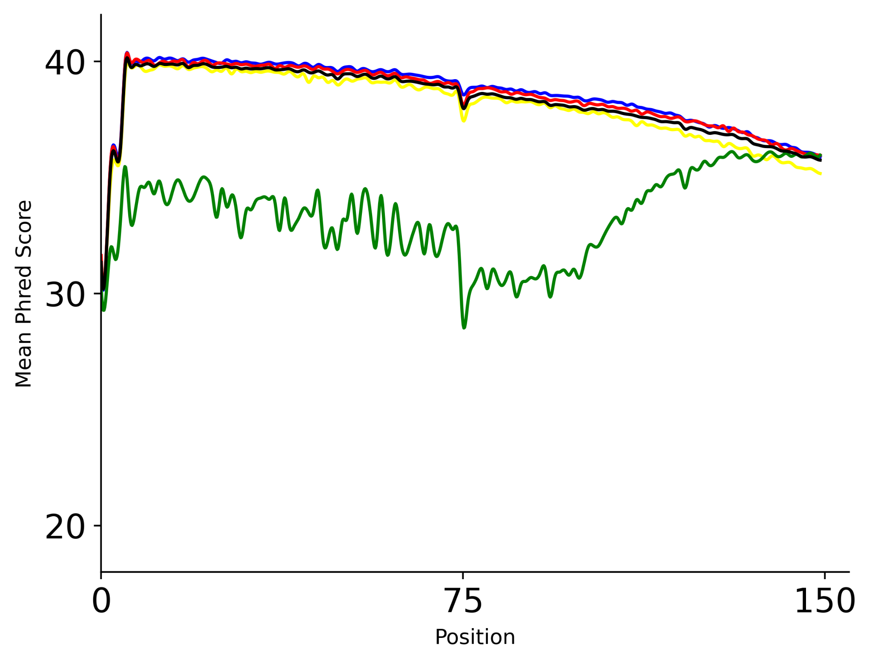
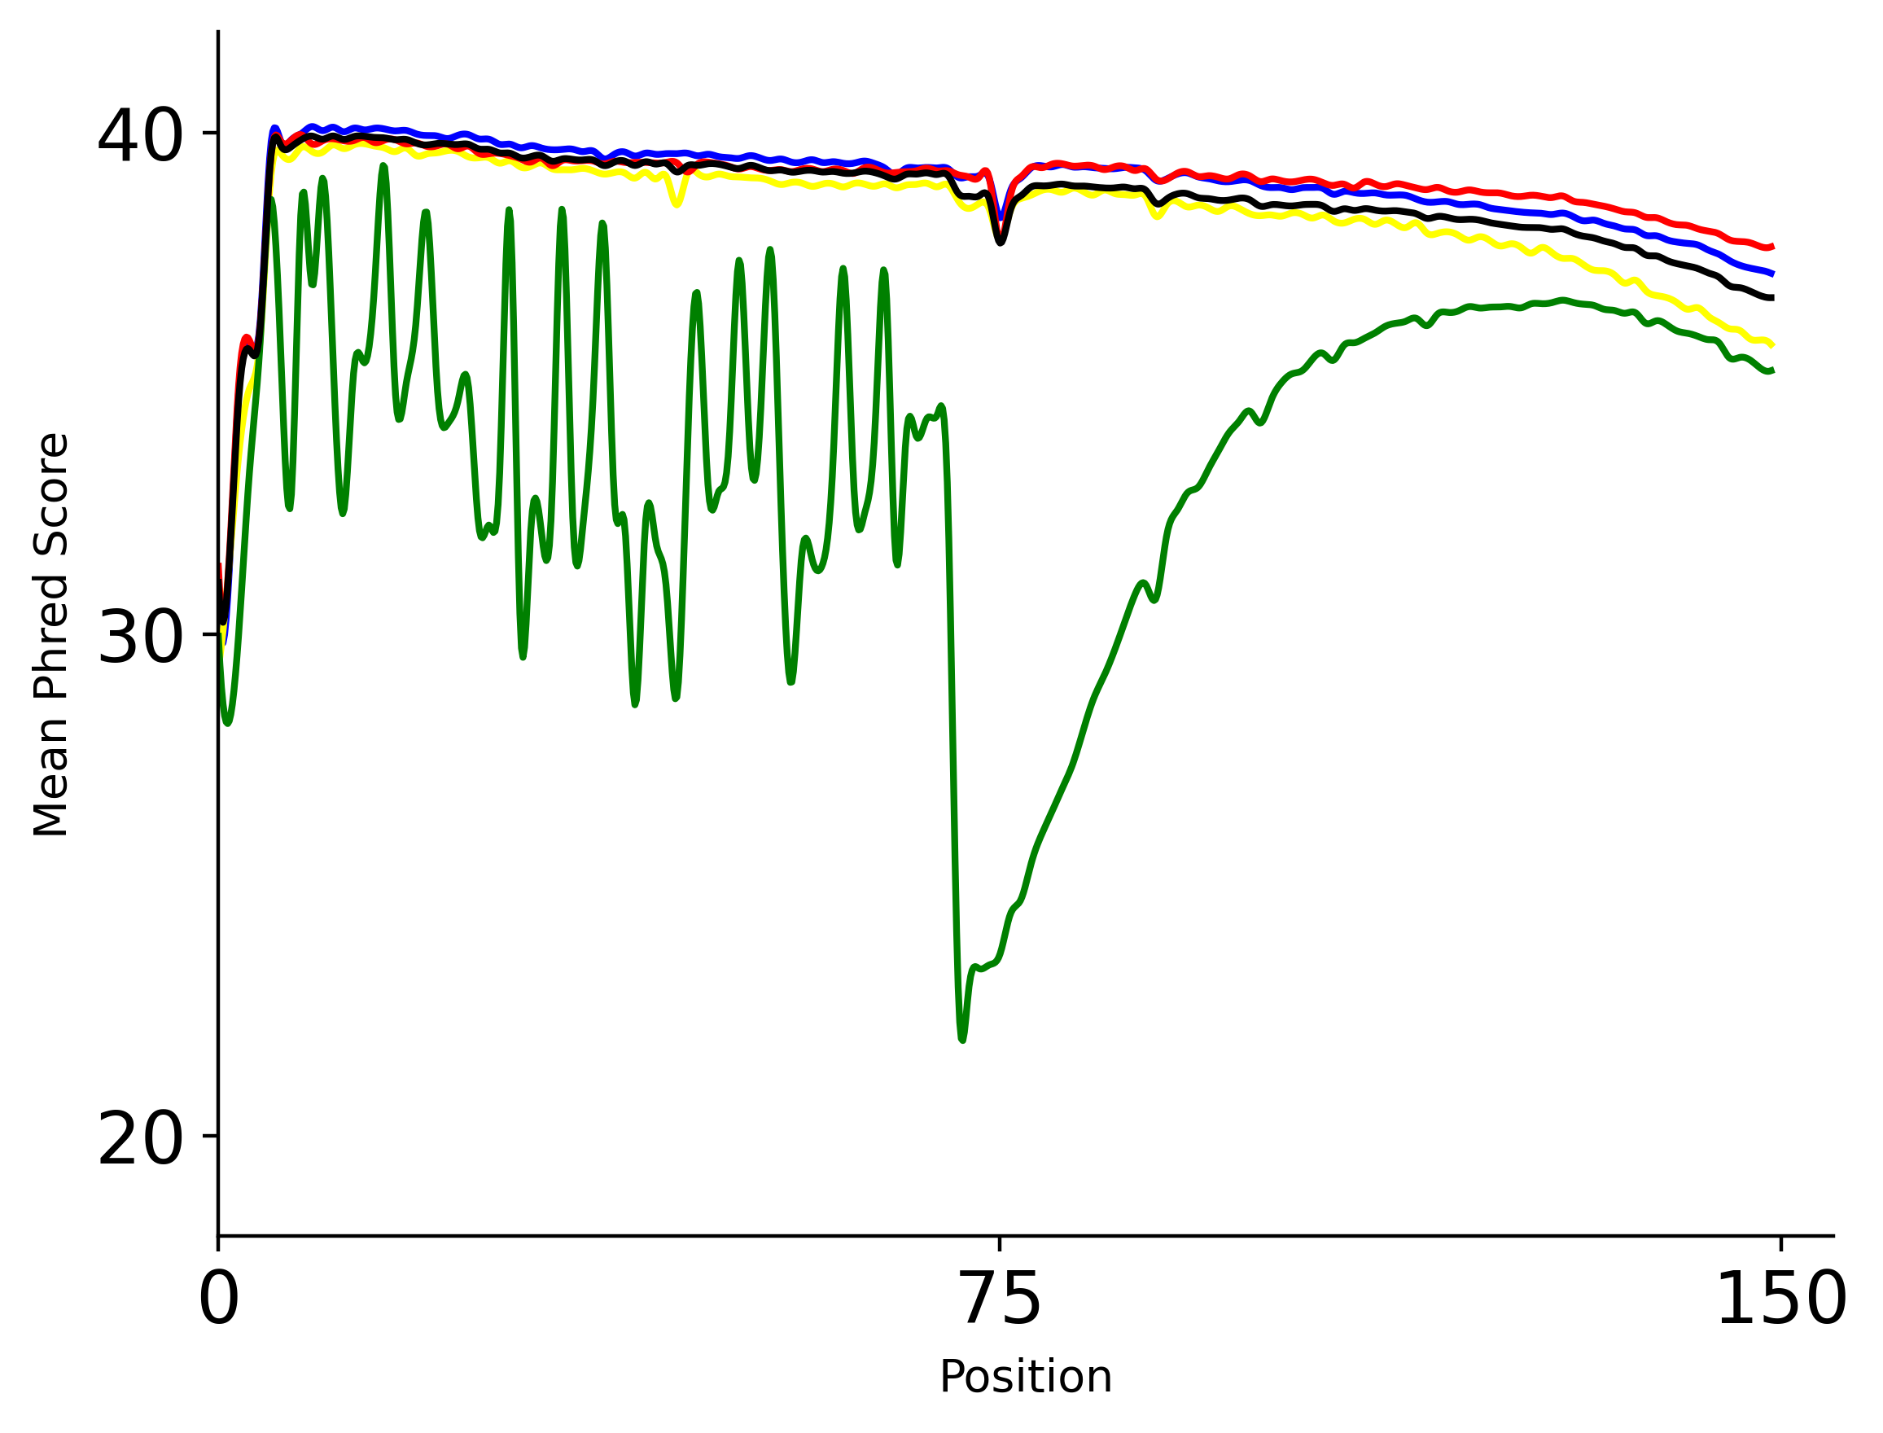
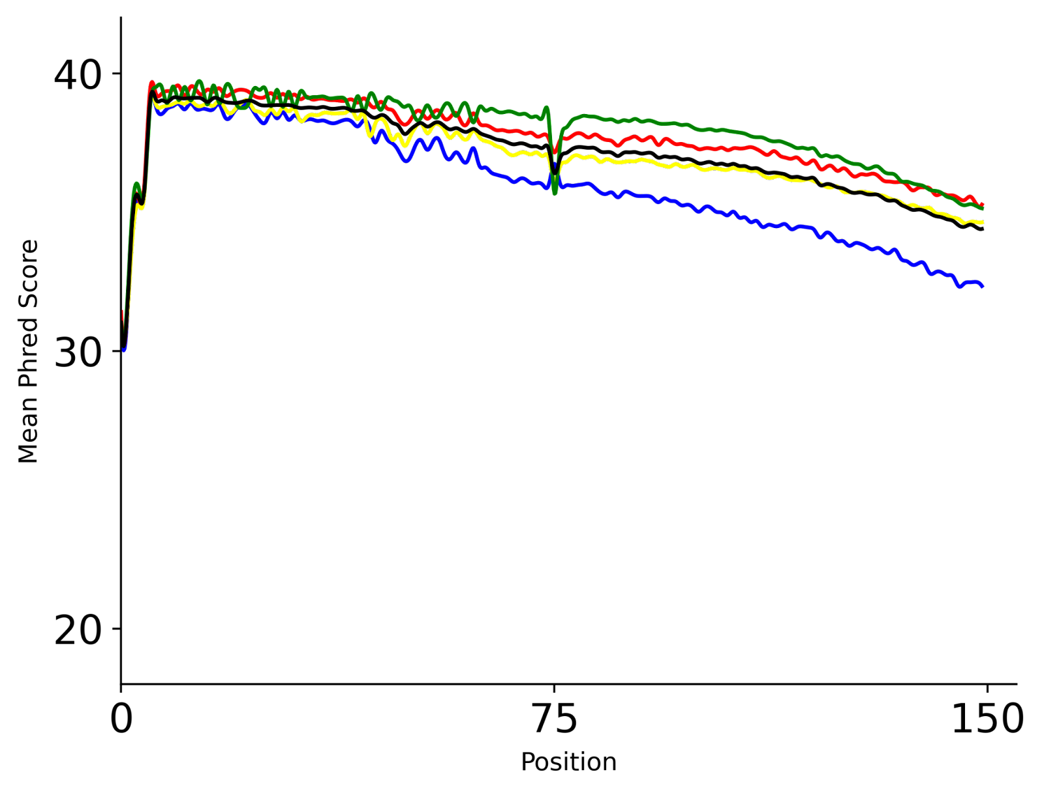
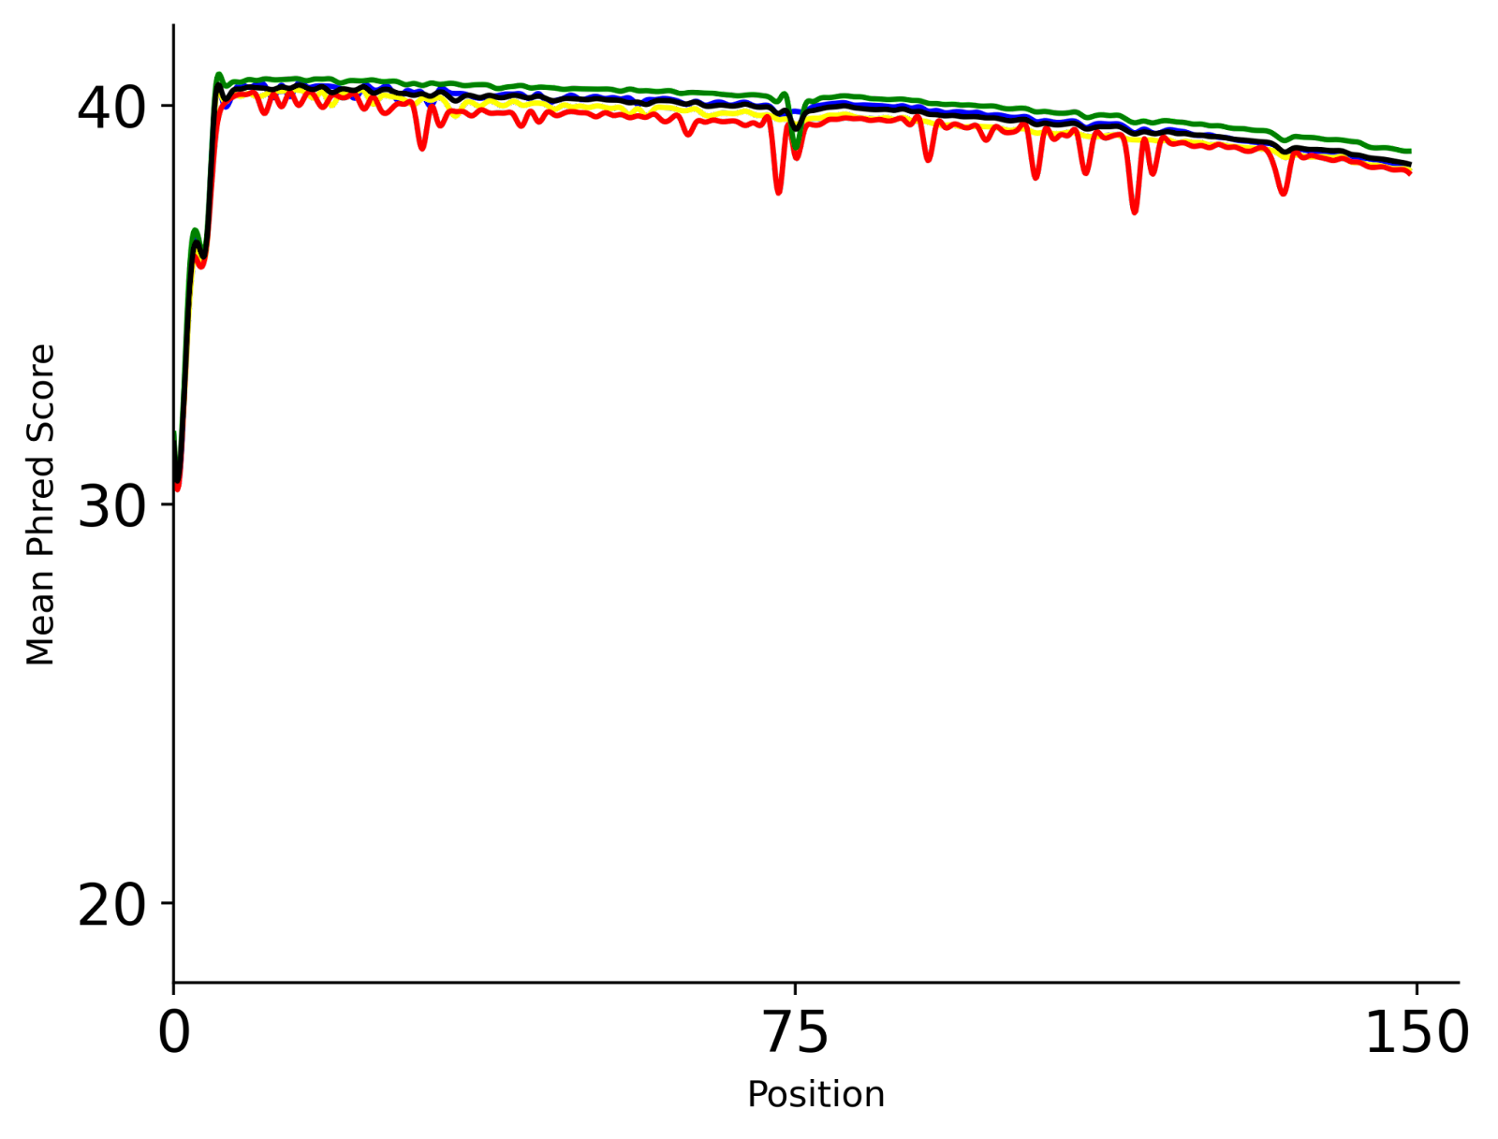
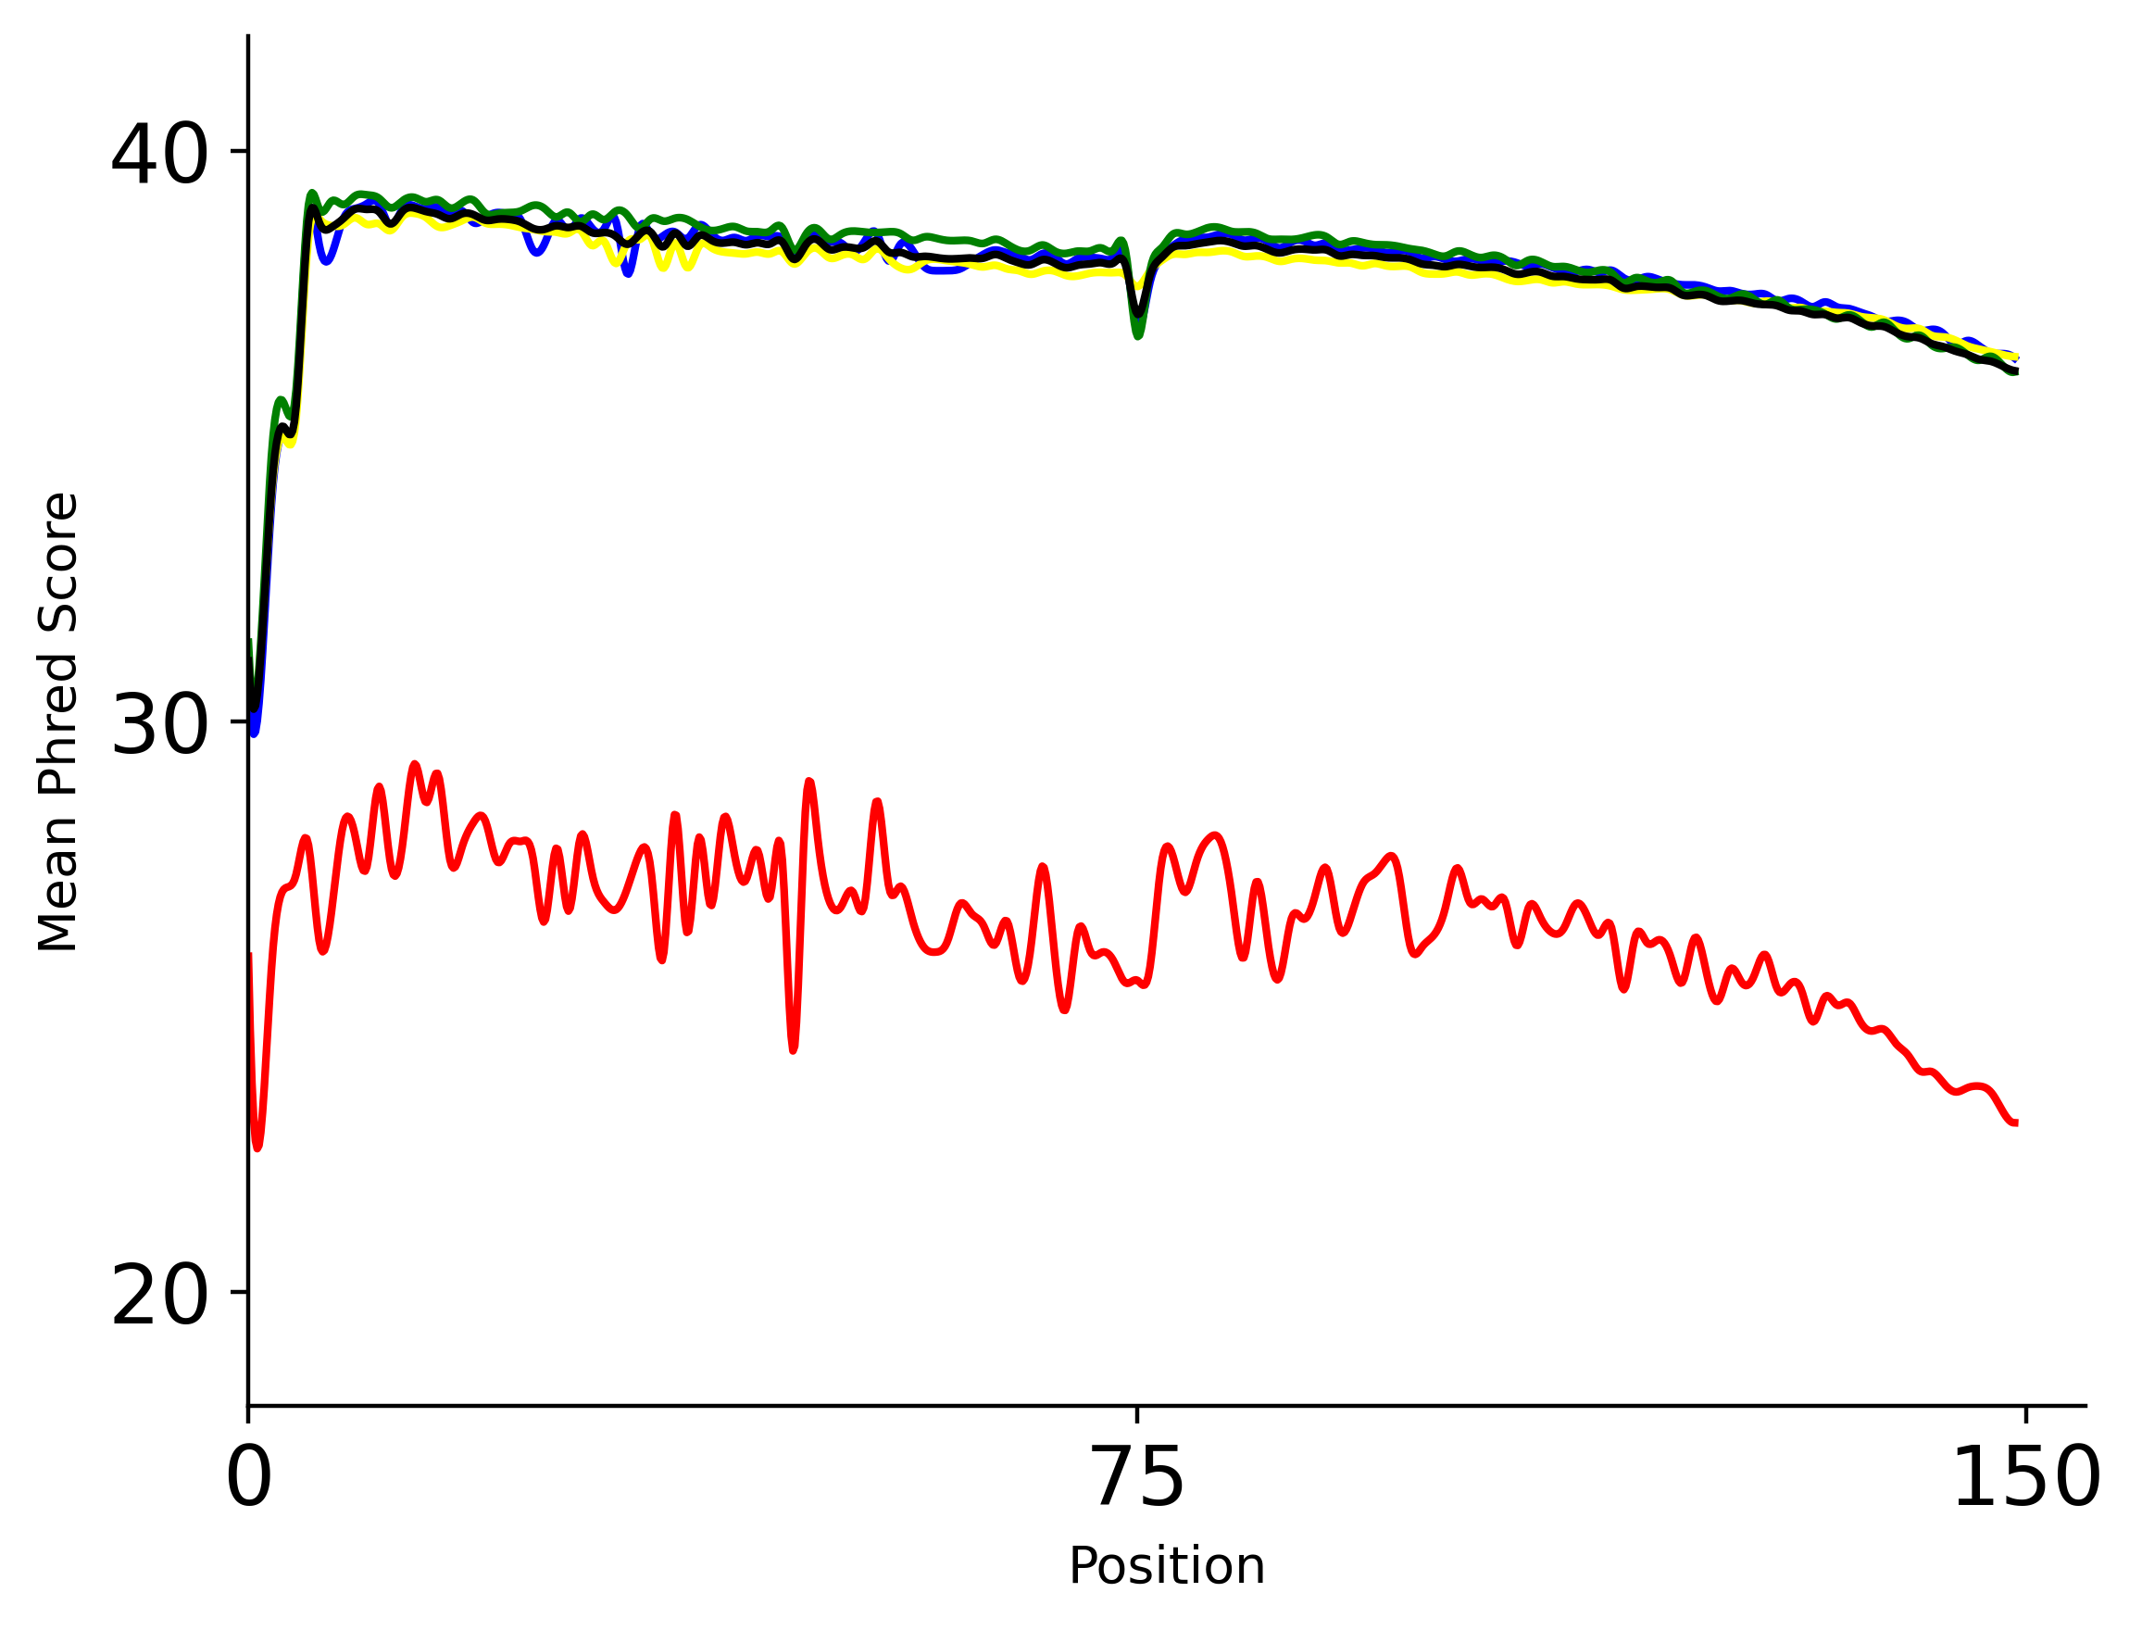
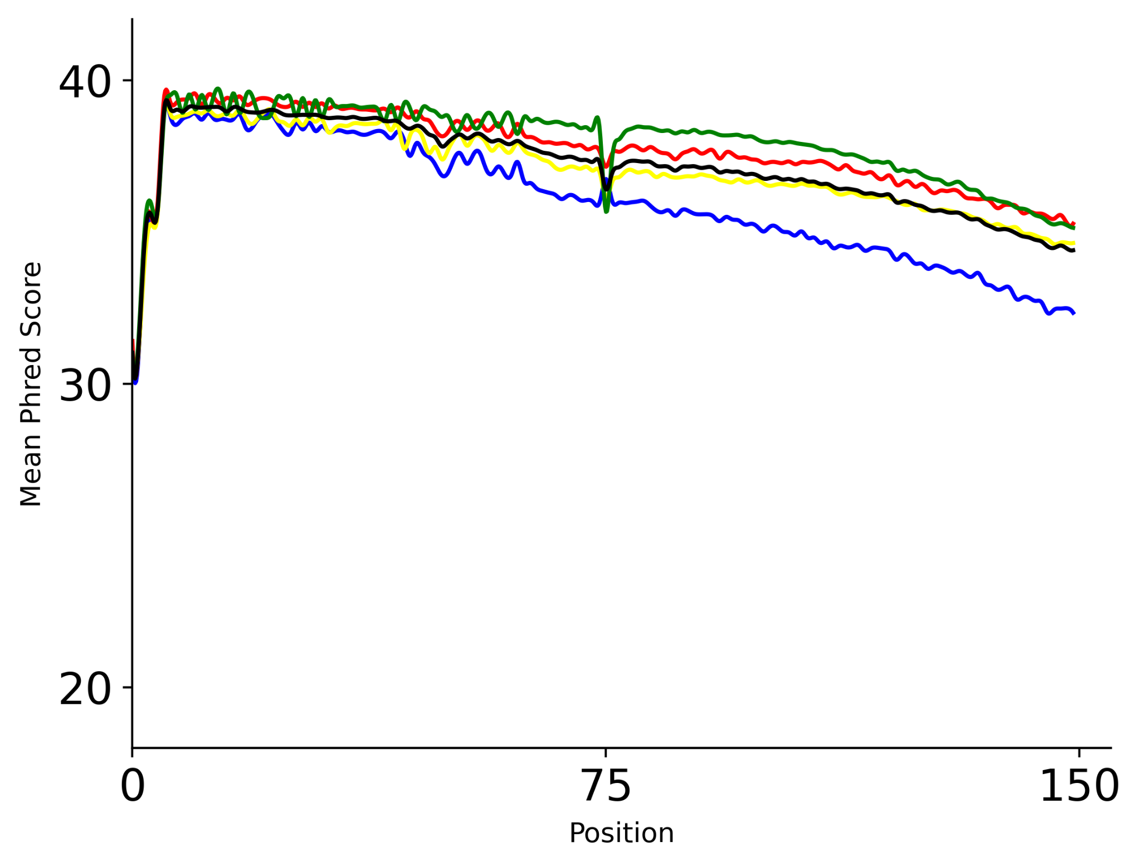
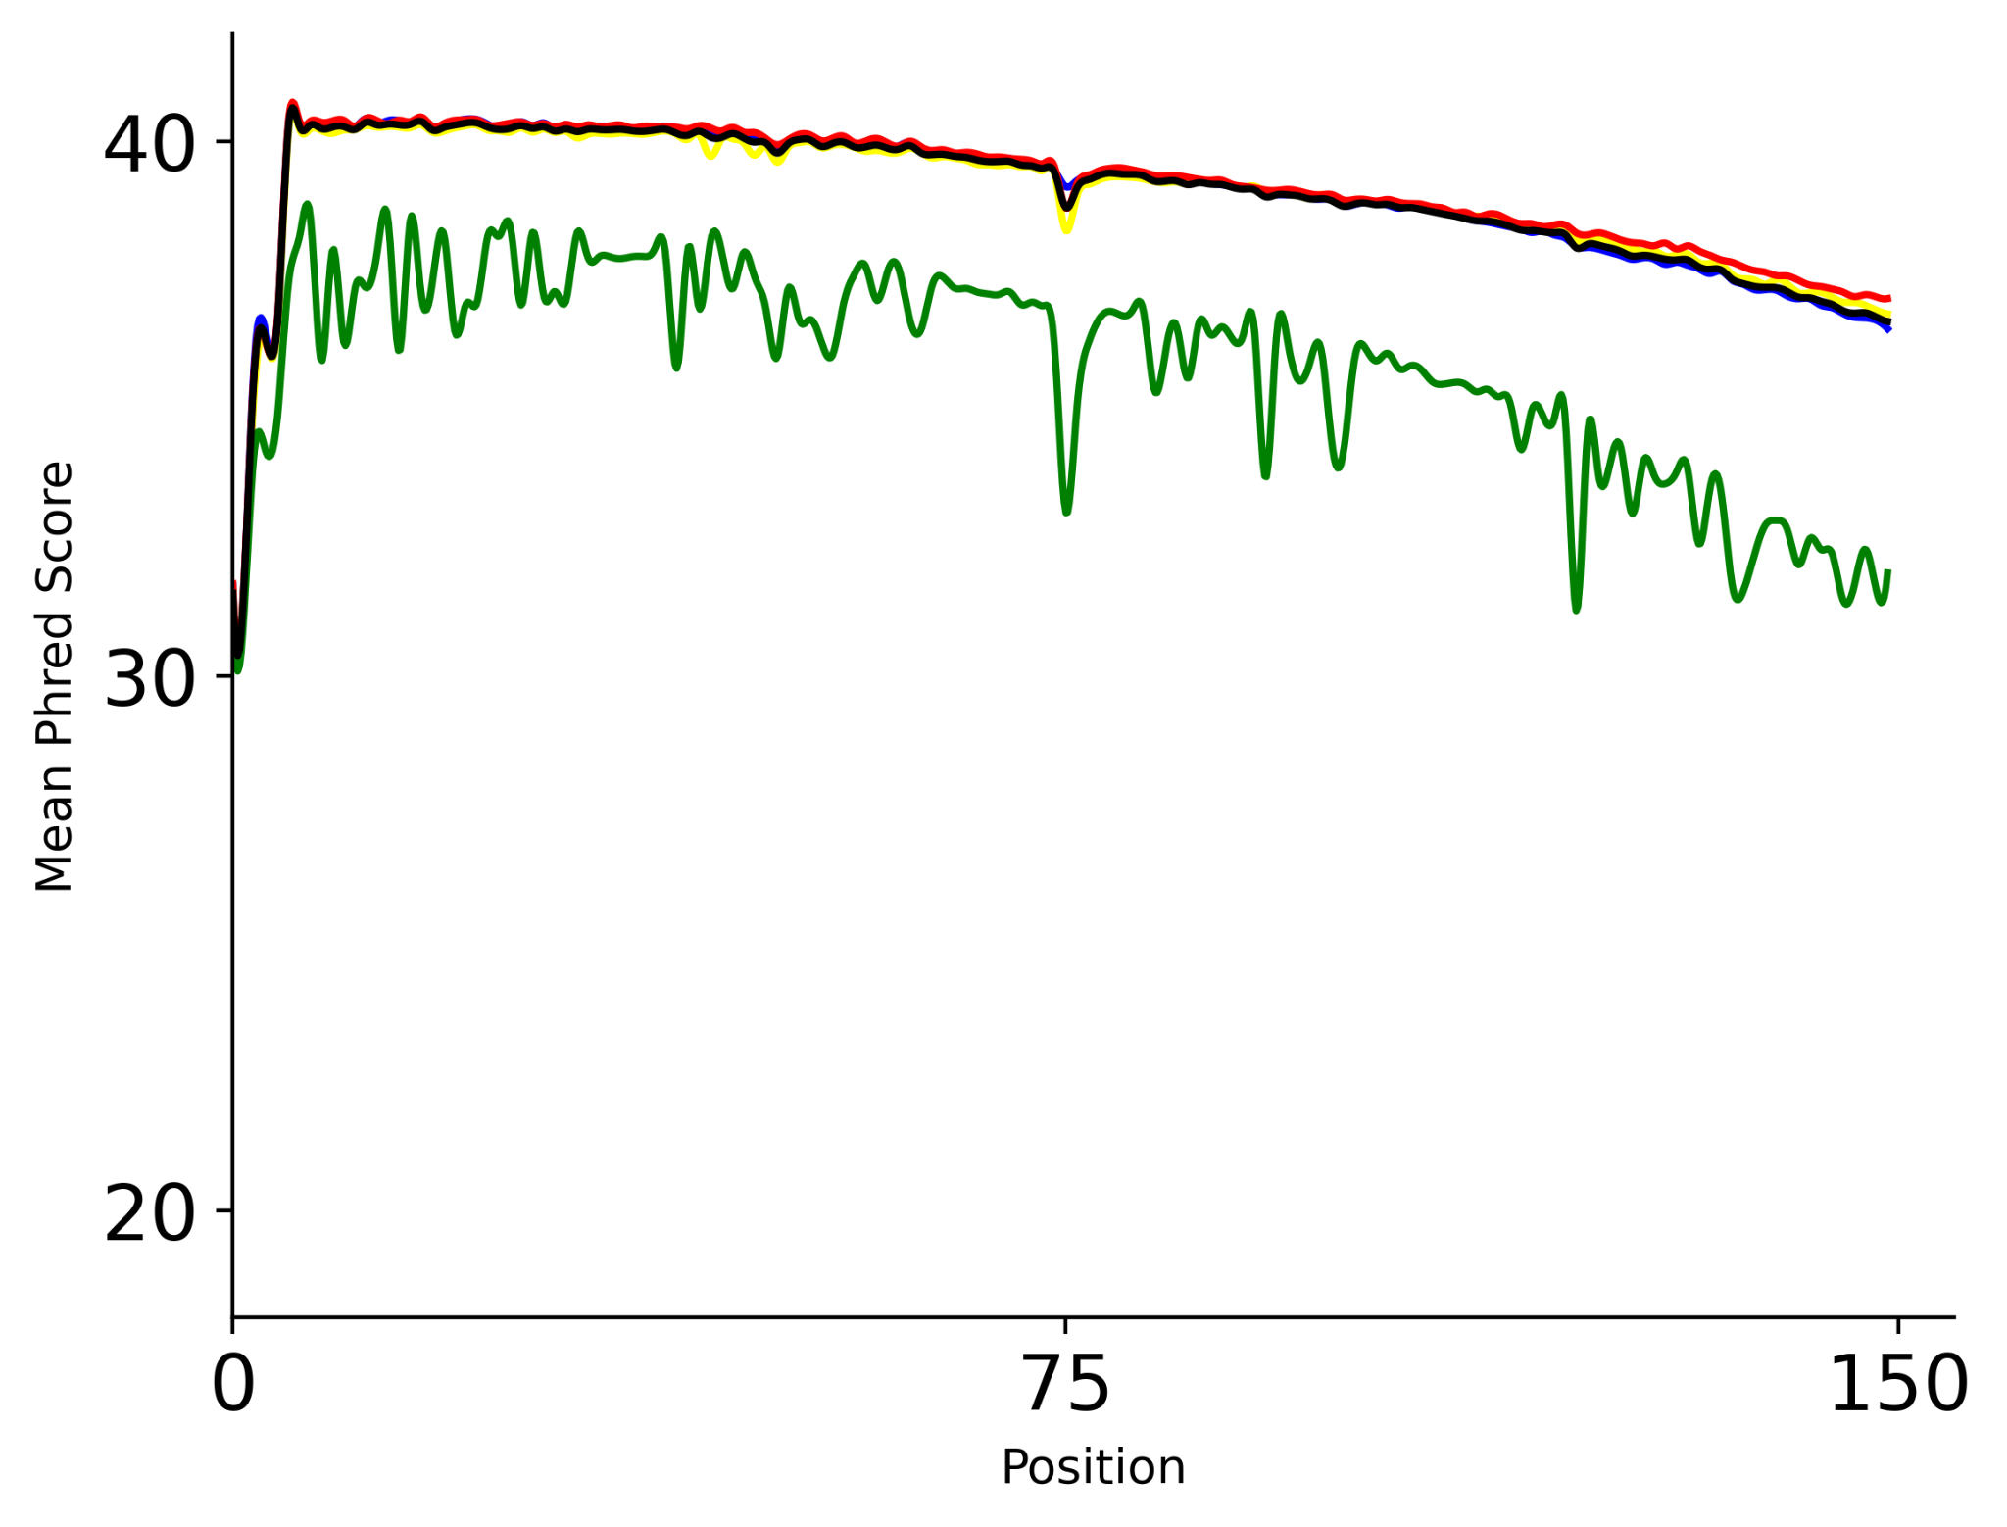
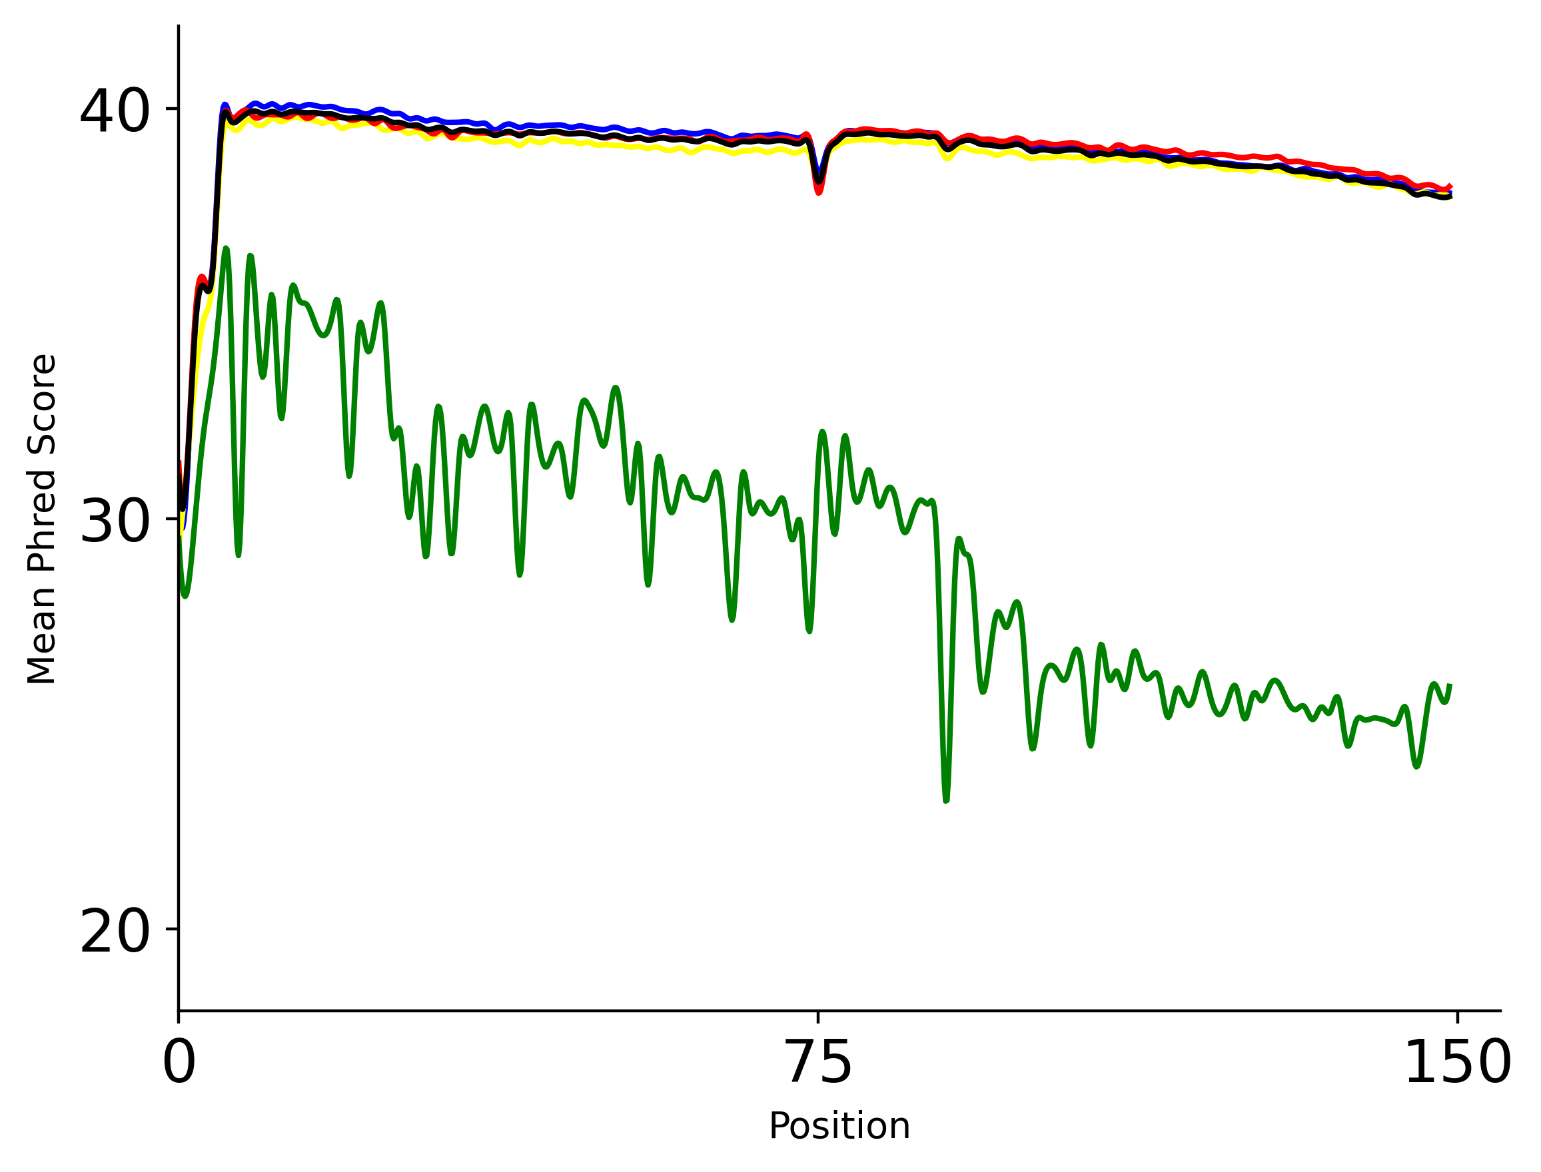
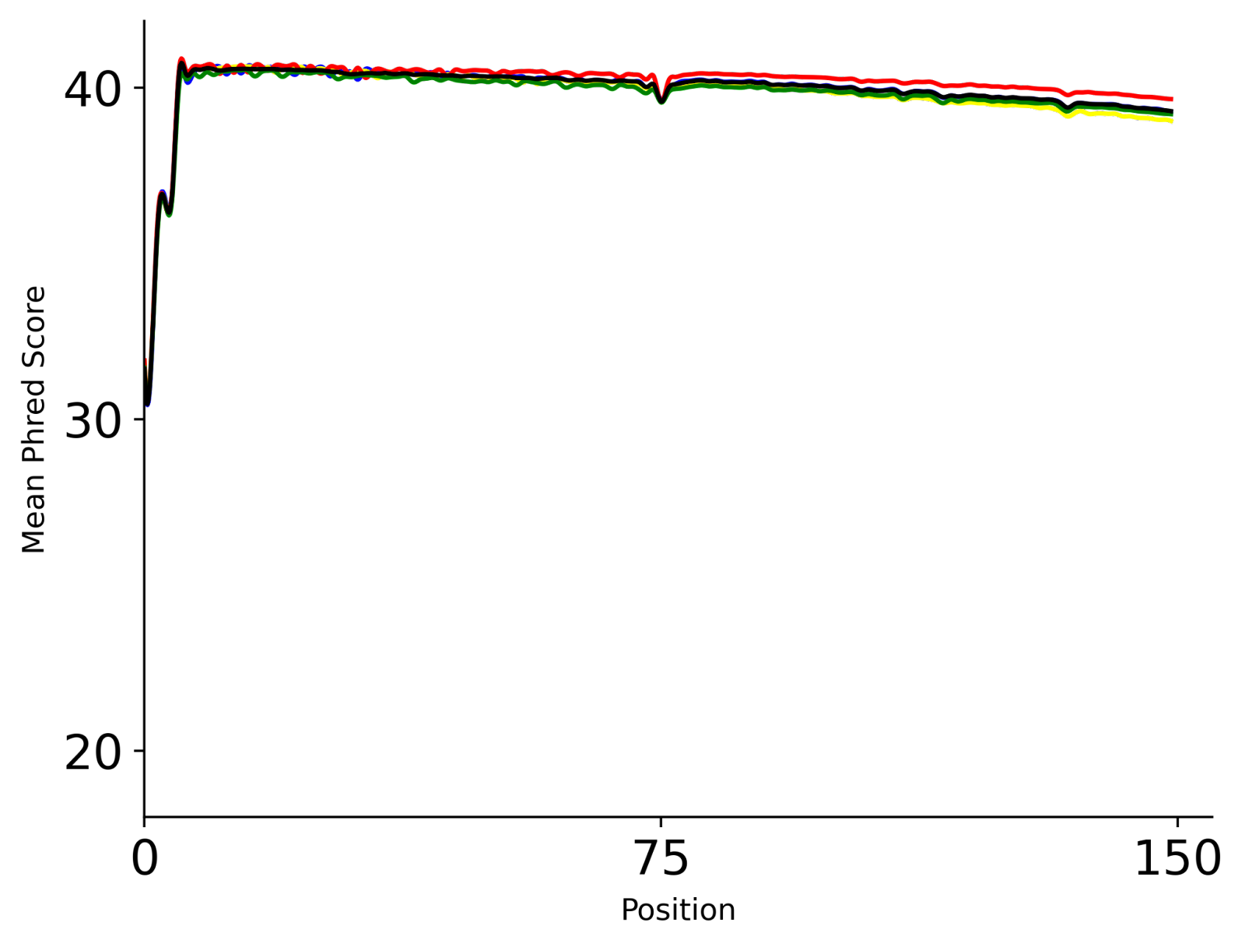
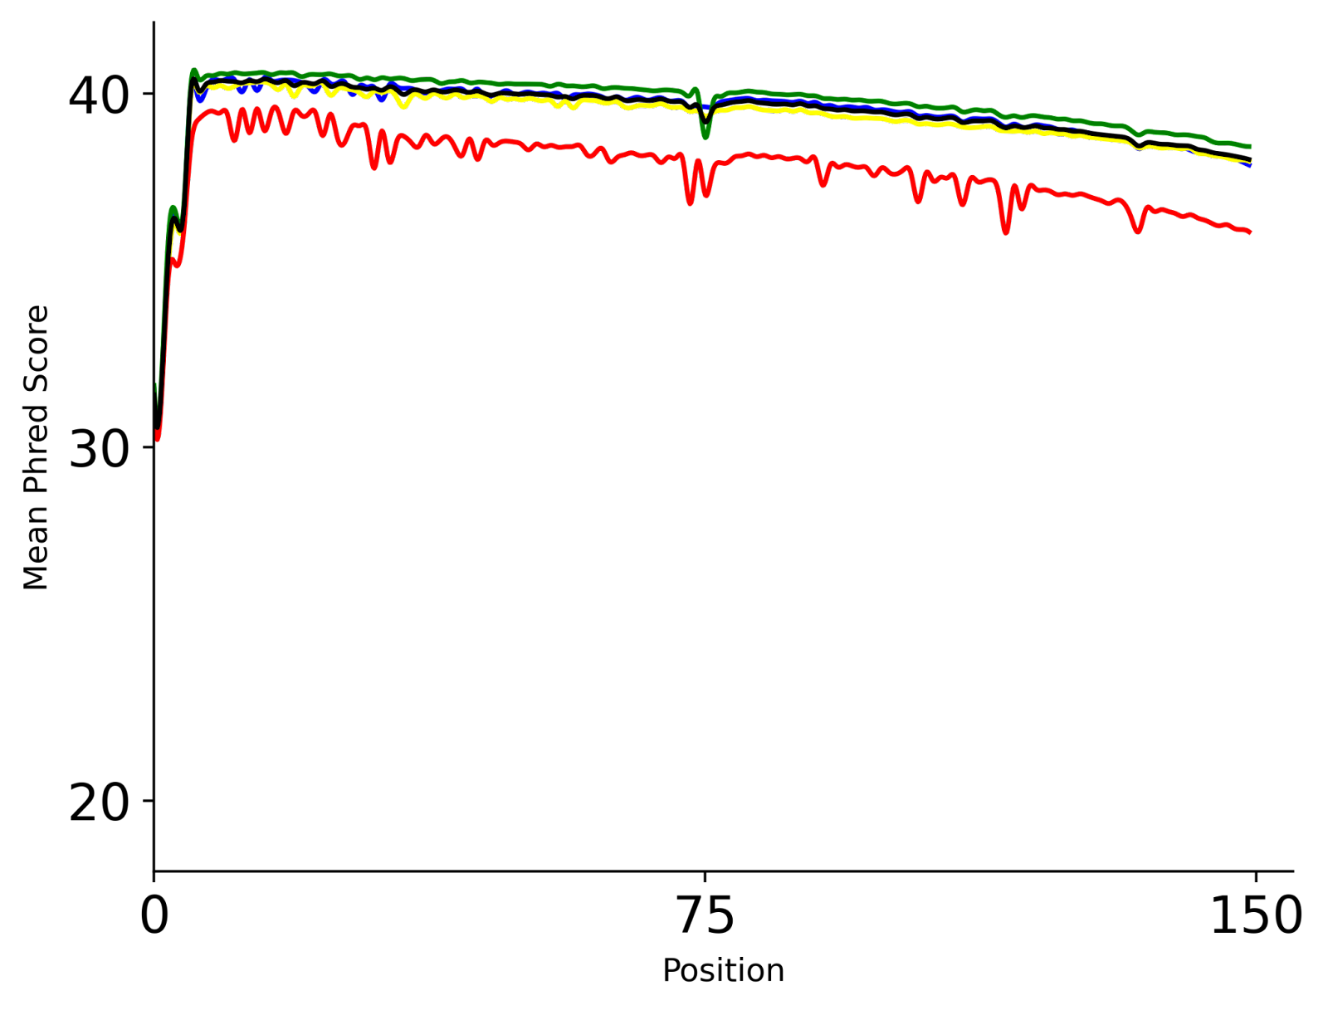
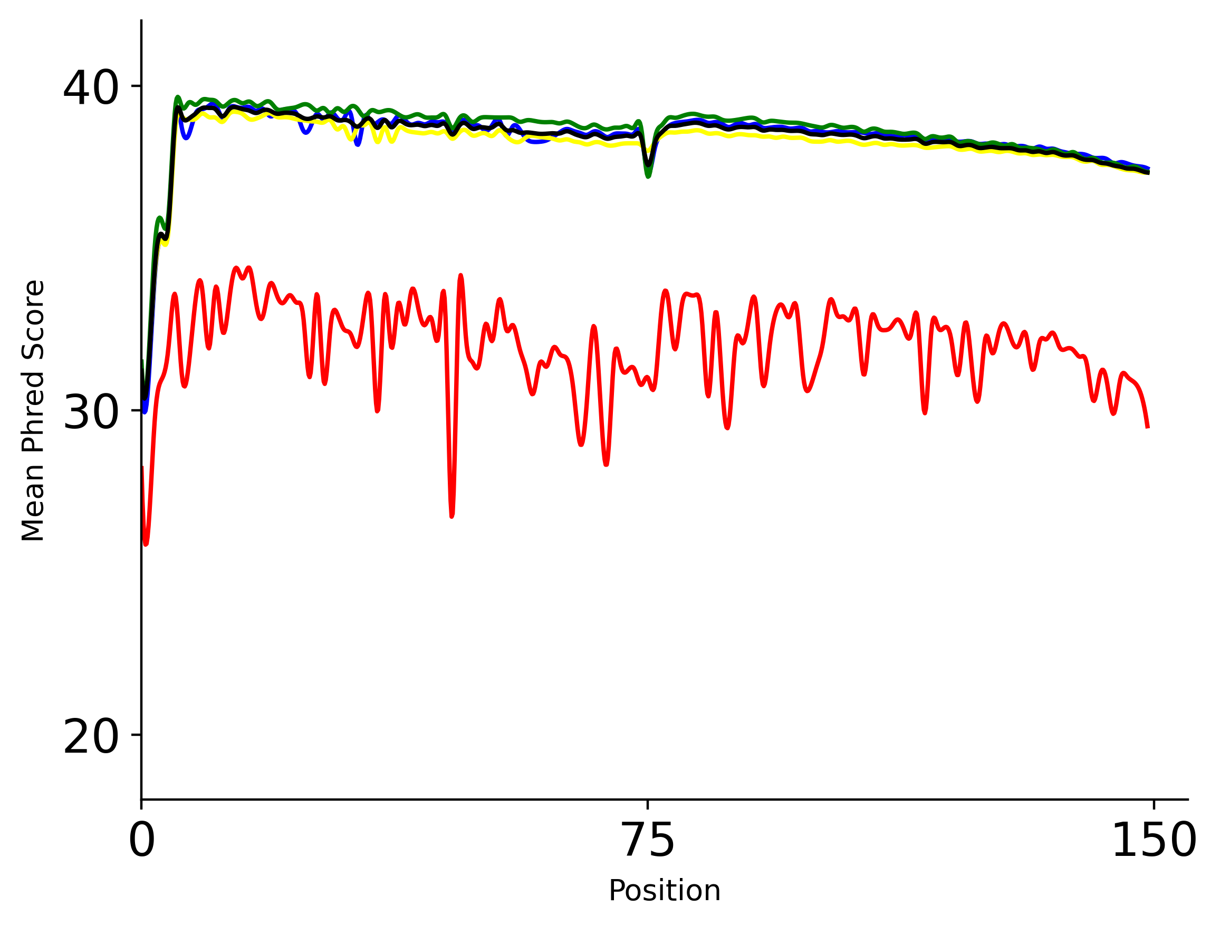
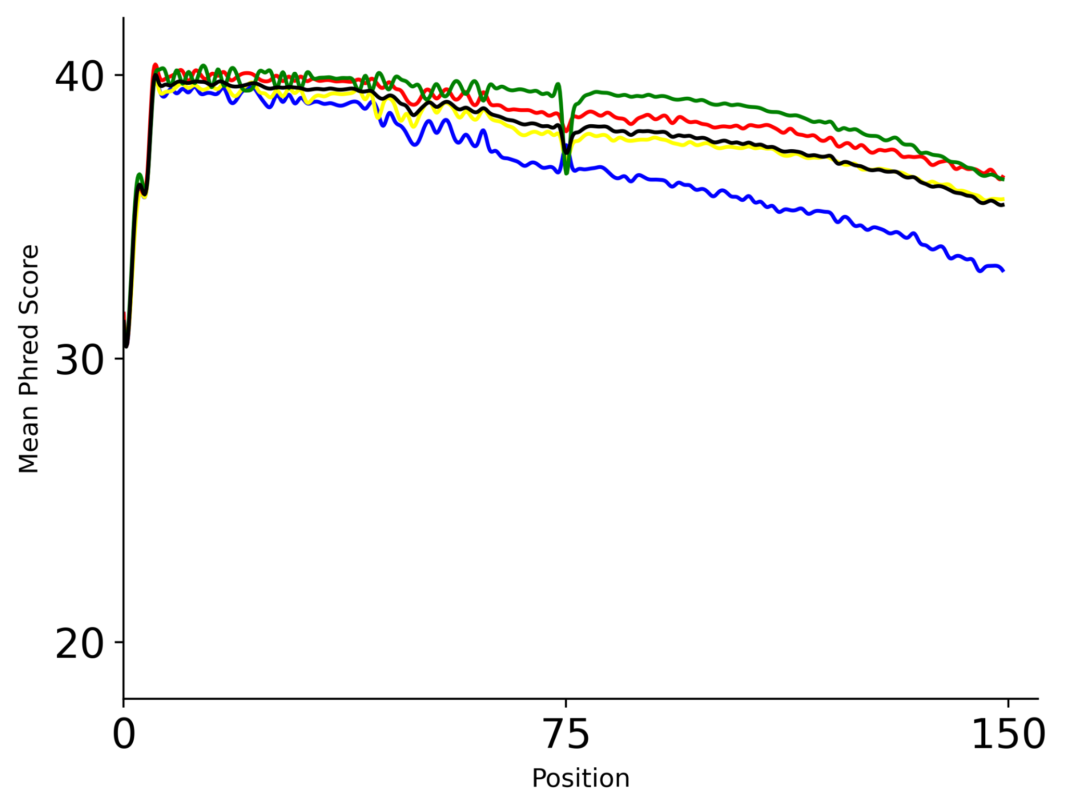
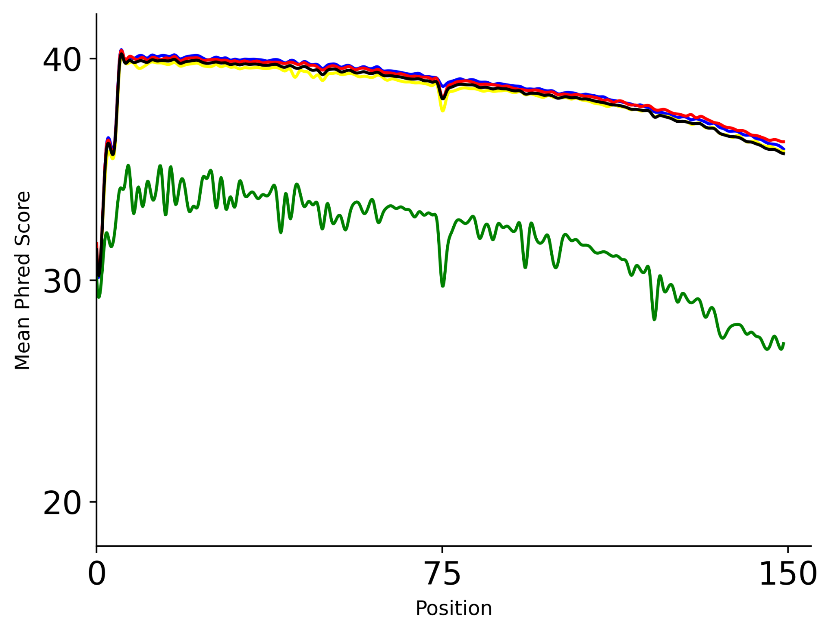
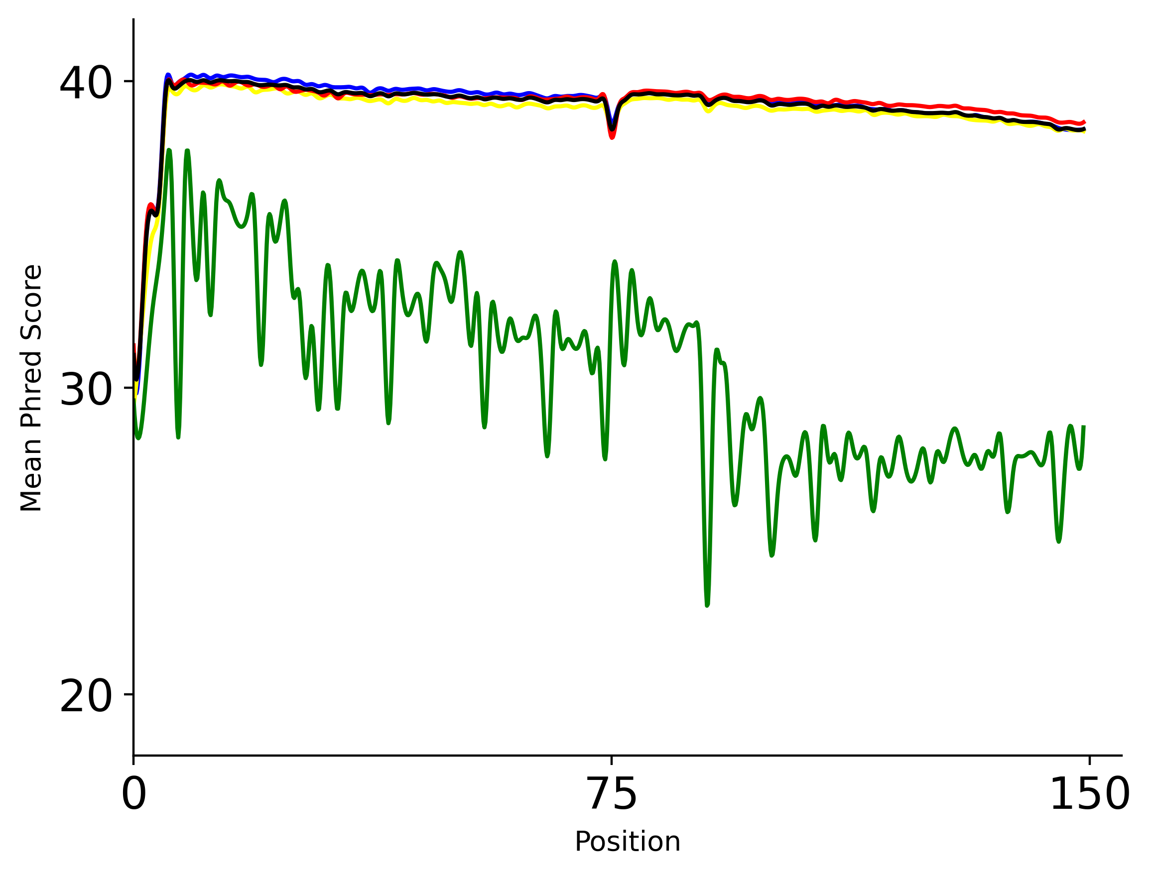
Mitochondrial
(RNAseq) Replicate 1
Mitochondrial
(RNA BS-seq) MT-C Replicate 1
Huang Replicate 4
40
30
20
i) Raw reads
Read 1
40
30
20
Read 2
40
30
20
ii) Sequence trimmed
Read 1
Phred Score
40
30
20
Read 2
40
30
20
iii) Quality filter
Read 1
40
30
20
Read 2
0 | 75 | 150
0 | 75 | 150
0 | 75 | 150
Position
Supplementary Figure 2. Mean per base sequence quality of Adenosine (blue), Thymine (yellow), Guanine (green), and Cytosine (red). A representative sample was chosen from each RNA BS-seq and RNA-seq library, with both Read 1 and Read 2 shown.

